Slide 1

Smugglers Cave

Slide 2



Who are smugglers cave?
Smugglers Cave are an animated band based in Dublin.
They were founded in 2013 while all three band members were studying in Trinity College.
Band members are:
~ Ken Jinn So – Guitar
~ Noel Darkarm – Singer
~ Drake Orrises - Drums

Slide 3

Achievements

Slide 4

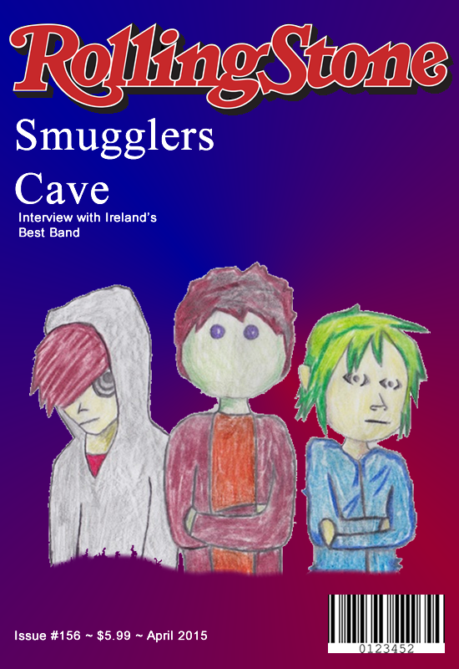
Achievements

Slide 5

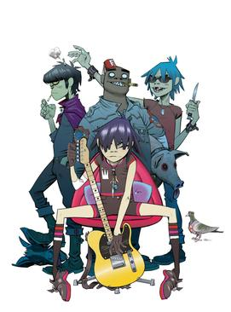

Inspiration

Slide 6

Inspiration
http://gorillaz.com/

Slide 7
The end Check out tour dates on our site

